Slide 1
Ishika Chaudhari (181091023)
(7,4) Hamming code:
Formation of Codeword matrix .
Error detection and Correction capability.
Finding minimum distance.
Finding Corrected Sequence , Syndrome and Message bit.
LINEAR CODES : BLOCK CODES AND CONVOLUTIONAL CODES
HAMMING CODES
CYCLIC CODES
Sayali Kulkarni (181091031)
Understanding Cyclic Codes:
Conversion of cyclic codes to polynomial form
Formation of Generator Matrix.
Formation of Codeword polynomial.
Calculating syndrome using modulo 2 division
Siddhi Pandare (181091075)
Linear Codes:
Formation of code word vector.
Error detection and correction capability.
Calculation of weights and minimum distance .
Finding Error pattern, Syndrome and Correction of given LBC.
Finding parity bits by time domain approach of Convolutional codes .

Slide 2
SYNDROME CALCULATION FOR CYCLIC CODES

Slide 3
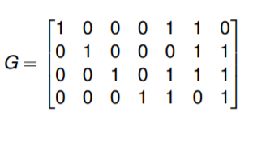
CYCLIC CODES
An (n, k) linear block code C is a cyclic code if every cyclic shift of a codeword in C is also a codeword.
Example: Consider the (7, 4) code C with generator matrix

Slide 4

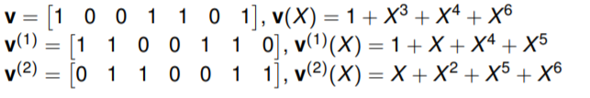
POLYNOMIAL REPRESENTATION OF CYCLIC CODES
For every vector v = [v0 v1 · · · vn−2 vn−1] there is a polynomial
Example:

Slide 5
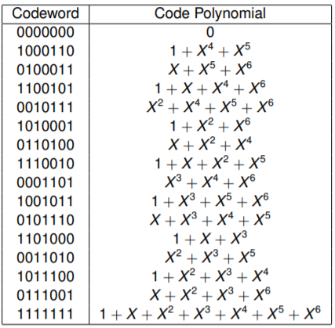
HAMMING CODE OF LENGTH 7

Slide 6
SYNDROME CALCULATION FOR CYCLIC CODES
Let us consider a systematic cyclic code and let us represent the received code vector R by the polynomial R(x). In general, R = C + E, where C is the transmitted code word and E is the error vector. Hence, we have
R(x) = C(x) + E(x) = Q(x) g(x) + S(x)
Here, S(x) is the syndrome polynomial of degree less than or equal to n-k-1.
If g(x) divides R(x) exactly, then S(x) = 0 and the received decoded word is Ĉ = R.

Slide 7
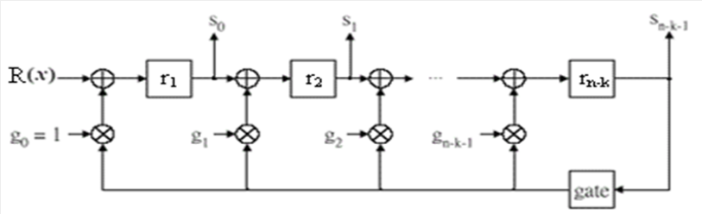
ANOTHER APPROACH
The division of R(x) by the generator polynomial g(x) may be carried out by means of a shift register which performs division as follows:

Slide 8
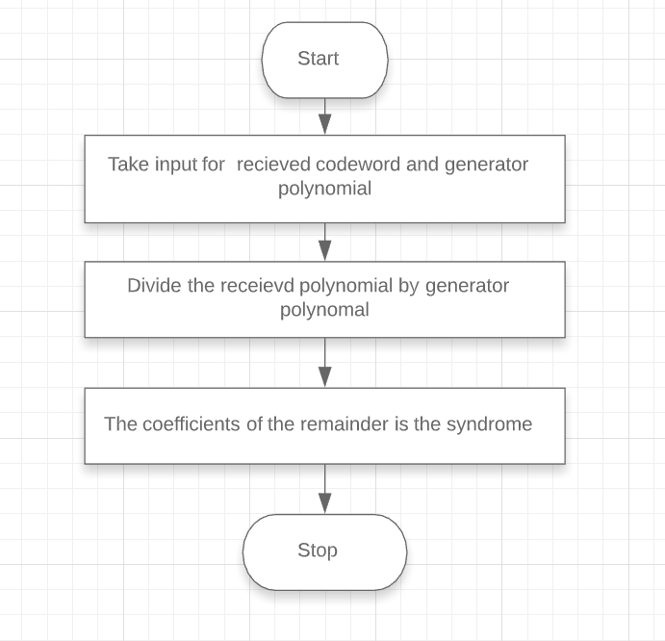
FLOWCHART FOR THE PROGRAM

Slide 9
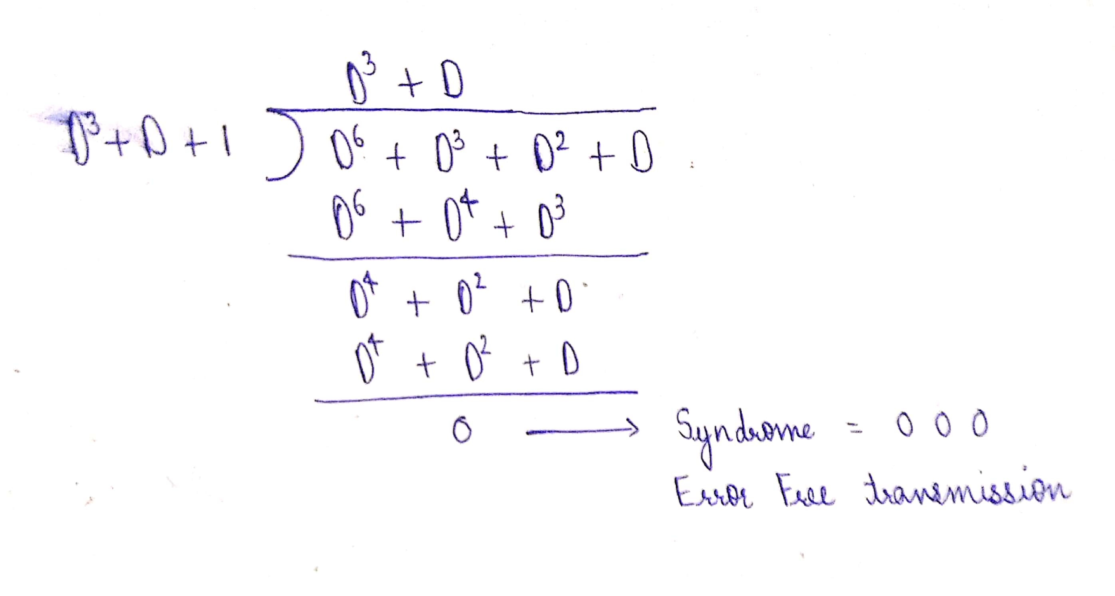
Suppose the received codeword is 0111001 and the generator polynomial is D³+ D + 1:

Slide 10
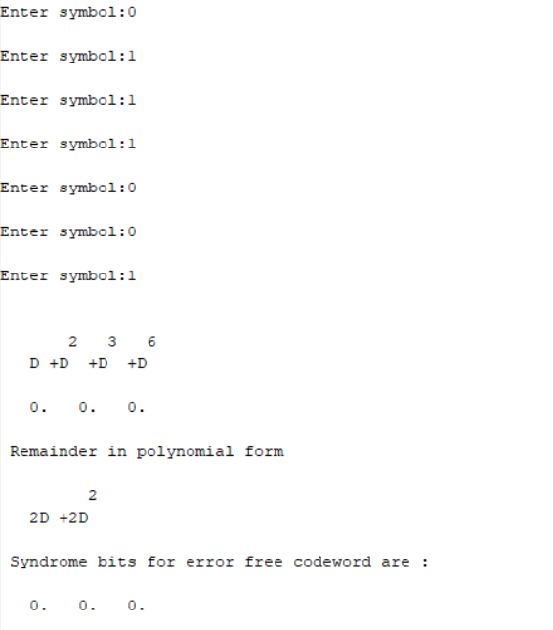
OUTPUT 1: ERROR FREE TRANSMISSION

Slide 11
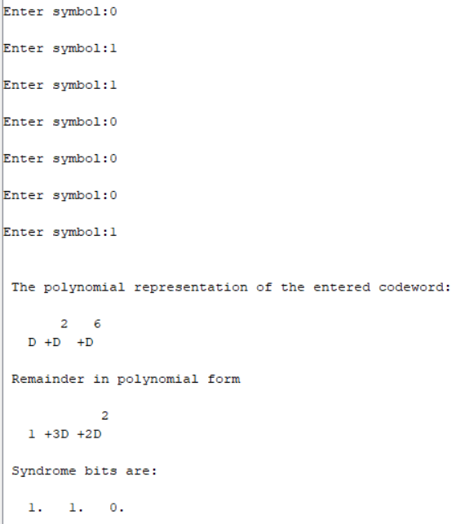
OUTPUT 2: RECEIVED CODEWORD CONTAINING ERROR:

Slide 12
LINEAR CODES - BLOCK CODES AND CONVOLUTIONAL CODES

Slide 13
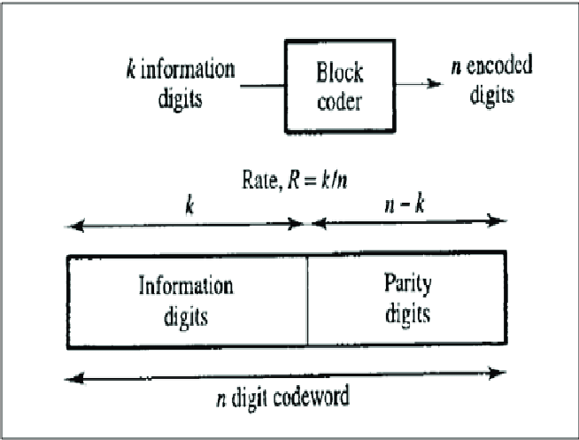
LINEAR CODES - BLOCK CODES AND CONVOLUTIONAL CODES
In coding theory, a linear code is an error-correcting code for which any linear combination of codewords is also a codeword.
In this form, the code word consists of (n-k) parity check bits followed by k bits of the message. The structure of the code is as shown:

Slide 14
LINEAR BLOCK CODES
User inputs:
k → Message length,
n → Code word length,
P → Parity matrix or coefficient matrix [size is (n-k)-by-k ].
I → Identity matrix
G = [P I_{𝑘} ] → Generator Matrix
∴ G = [ P eye(k,k) ] gives the Generator Matrix
The parity check matrix H is given as:
H = [I_{n-k} P^{T}]
∴ H =[ eye(n-k,n-k ) P’ ] gives the Parity check matrix

Slide 15
GENERATION OF CODEWORDS FROM MESSAGE BITS
All_M is all the combinations of message sequences depending upon the length of the message defined by user.
Code Word Matrix = [message *Generator Matrix] = [m mP]
∴CodeWordMat= All_M * G
CodewordMat= modulo (C ,2) calculates Code word Matrix
Note: modulo() is used to for modulo 2 operations of binary bits

Slide 16
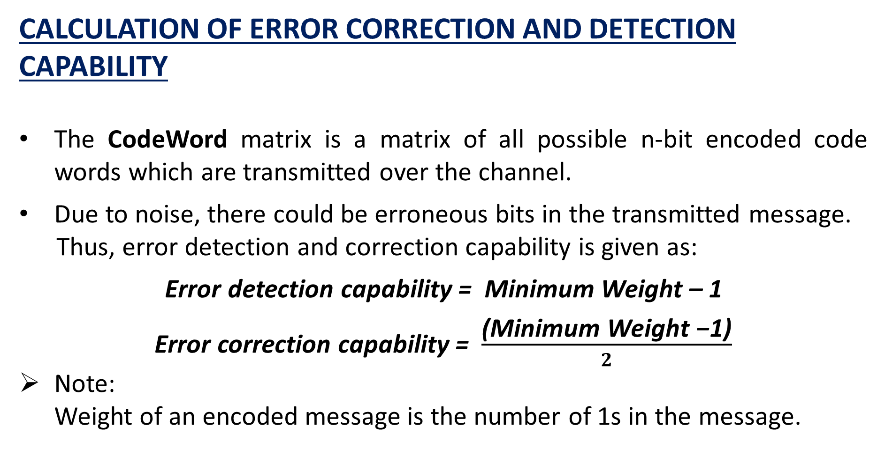
CALCULATION OF ERROR CORRECTION AND DETECTION CAPABILITY
The CodeWord matrix is a matrix of all possible n-bit encoded code words which are transmitted over the channel.
Due to noise, there could be erroneous bits in the transmitted message.
Thus, error detection and correction capability is given as:
Error detection capability = Minimum Weight – 1
Error correction capability = $\frac{\text{(}\text{Minimum} \text{Weight}\text{ −1)}}{2}$
Note:
Weight of an encoded message is the number of 1s in the message.

Slide 17
SYNDROME CALCULATION
When there is an error, the decoding operation will give a syndrome vector, whose elements contain at least one non-zero element.
Syn → Syndrome
Syndrome (S) = Y*H^{T}
∴ Syn= Y *(H’)
Syn=modulo(Syn,2) calculates the Syndrome

Slide 18
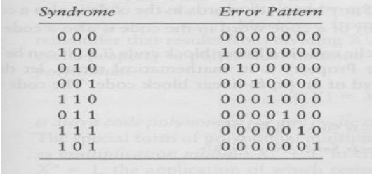
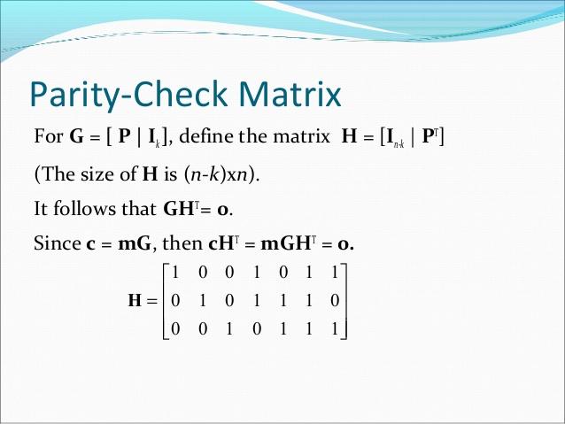
Error Pattern is an error vector E whose non-zero elements mark the position of the transmission errors in the received codeword.
All the syndromes can be worked out by column wise transposing the Parity check matrix H. Thus, we can find the corresponding error patterns for decoding purposes.
Example: For a (7,4) Linear Block Code the error pattern, Syndrome and Parity check matrix is given below:

Slide 19
ERROR DETECTION
Y denotes the 1-by-n received vector that results from sending the code vector CodeWord over a noisy channel.
The code word corresponding to the entered message string is extracted from the CodeWordMat using:
z=bin2dec(M)+1 → M is the entered message string CodeWord=CodeWordMat(z,:)
Using rand() function we generate a random number from 1-n
This is the position of error in the transmitted message sequence
Y=CodeWord is the transmitted erroneous encoded message

Slide 20
ERROR CORRECTION AND DECODING
ErrPattern →Error Pattern Matrix
ErrPos → Position of error in the sequence
We initialise ErrPattern to a zero vector of size 1-by-n and ErrPos to 1
Using a while loop we compare the Syndrome to d where d=[H(:,ErrPos)]’. On every iteration we increment ErrPos by 1
If d is equal to the Syndrome we break the loop and update ErrPattern as:
ErrPattern(ErrPos)=1
Corrected Code word = Received erroneous Code word + Error Pattern
∴ CorrectedCodeWord= [CodeWord + ErrPattern] gives the
corrected code word

Slide 21
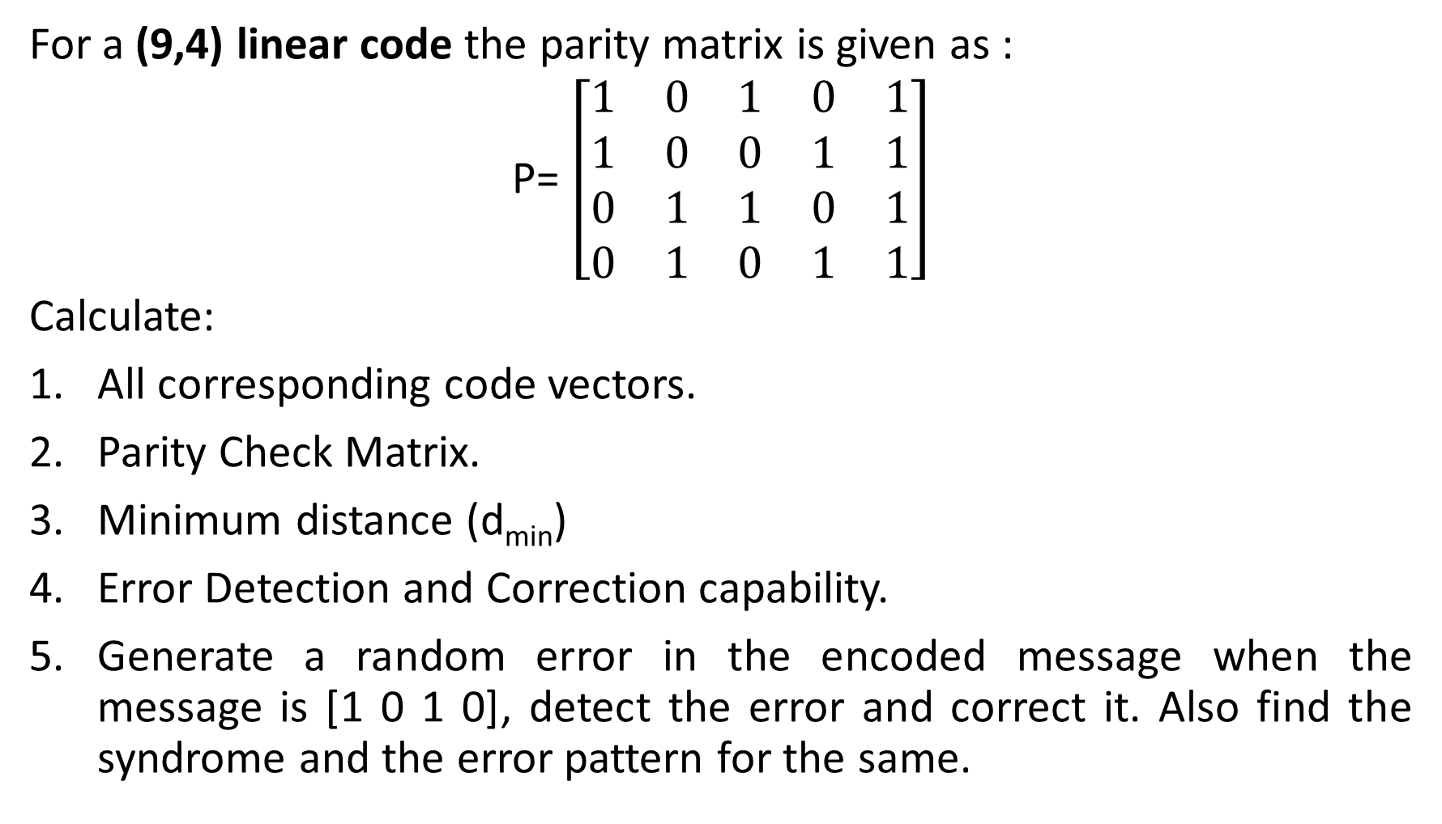
Example 1: (9,4)
For a (9,4) linear code the parity matrix is given as :
P= $\left[\begin{matrix}1 & 0 & 1 & 0 & 1 \\ 1 & 0 & 0 & 1 & 1 \\ 0 & 1 & 1 & 0 & 1 \\ 0 & 1 & 0 & 1 & 1\end{matrix}\right]$
Calculate:
All corresponding code vectors.
Parity Check Matrix.
Minimum distance (d_{min})
Error Detection and Correction capability.
Generate a random error in the encoded message when the message is [1 0 1 0], detect the error and correct it. Also find the syndrome and the error pattern for the same.

Slide 22
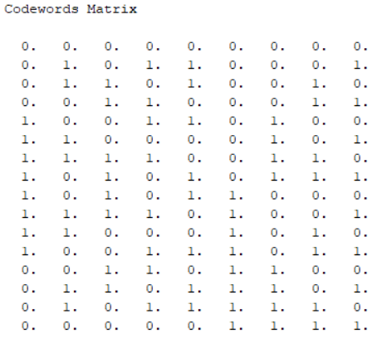
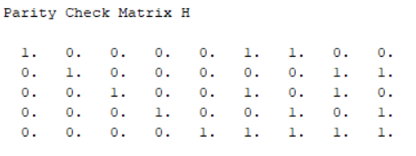
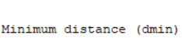

Answer 1 (Scilab Output)
1.Code vectors | 2. Parity Check Matrix | 3. Minimum distance d_{min}

Slide 23
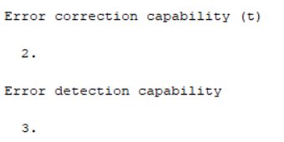
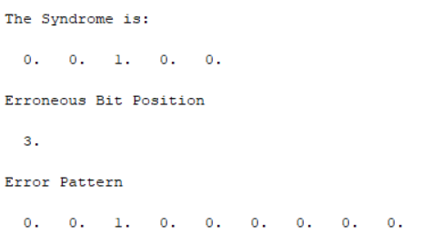

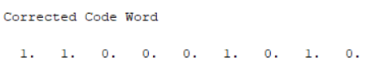
4. Error Correction and Detection capability | 5.A Syndrome and Error pattern | 5.B Erroneous and Corrected message

Slide 24
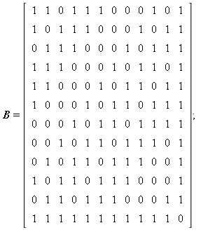
Example 2: Extended Golay Codes
For the (24,12) that is extended Golay Code find the minimum distance (d_{min}). The parity matrix is given as:
P

Slide 25

ANSWER 2 (SCILAB OUPUT)
The minimum distance (d_{min}) is:
This proves the properties of extended Golay Code:
The weight of every codeword in G₂₄ is a multiple of 4.
The code G₂₄ has no codeword of weight 4, so the minimum distance of G₂₄ is d = 8.

Slide 26
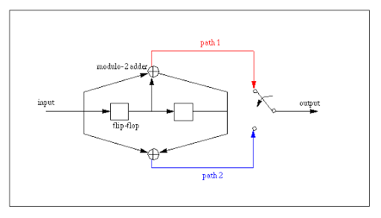
LINEAR CONVOLUTIONAL CODES
In telecommunication, a convolutional code is a type of error-correcting code that generates parity symbols via the sliding application of a boolean polynomial function to a data stream.
CONVOLUTIONAL ENCODER

Slide 27


GENERATION OF PARITY BITS BY TIME DOMAIN APPROACH :
User Input:
g1 → top-adder sequence (no bits restriction )
g2 → bottom –adder sequence
m → message sequence
In the time domain approach, the output by convolution is given as:
Top output sequence = X_{i}¹ =
Bottom output sequence = X_{i}² =
$$\sum_{l=0}^{m}{g1l mi−l}$$
$$\sum_{l=0}^{m}{g2l mi−l}$$

Slide 28
In each iteration of while loop, we extract n-bits from the message sequence where n is the length of the adder sequence.
We element wise multiply top/bottom adder sequence with these n-bits and store the convoluted output in a matrix.
We iterate the while loop till we exhaust the message bits.
Thus, while (i ~= (length(m1)-k+2))
tempmat=m1((i:i+l-1))
temp=modulo((g1*tempmat'),2)
x1=[x1 temp]
i=i+1
end
gives the parity bits from the top adder. Similarly, we get parity bit from the bottom adder.

Slide 29
CHECK:
Scilab has the function convol() which can be used to check our output.
Thus, g1=flipdim(g1,2)
g2=flipdim(g2,2)
x1 = round(convol(g1,m))
x2 = round(convol(g2,m))
x1 = modulo(x1,2)
x2 = modulo(x2,2)
should give the same output.
Note:
In convol(), indexing is from left to right hence flipdim() must be used to flip g1 and g2.

Slide 30
EXAMPLE:
Find the output parity bits from a Convolutional Encoder where:
Top adder sequence = [1 0 1 1]
Bottom adder sequence =[ 1 0 0 1]
Message sequence = [1 0 1 1 1 0 1 1 0 1]
Also find the total number of parity bits.

Slide 31
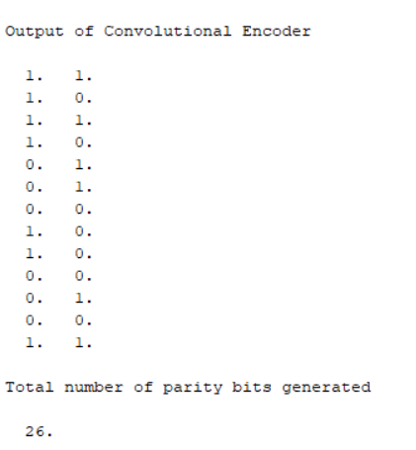
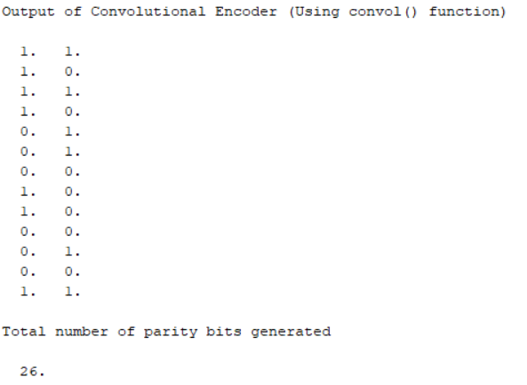
ANSWER (SCILAB OUPUT)
Using loops : | Using Scilab built-in function:

Slide 32
HAMMING CODE : ENCODING AND DECODING

Slide 33
WHAT IS HAMMING CODE?
Hamming code is an error correcting code that can be used to correct single bit and double bit errors . It can correct single bit errors tat can occur wen binary data is transmitted from one device to another.
Hamming code is a block code that is capable of detecting up to two simultaneous bit errors and correcting single-bit errors. It was developed by R.W. Hamming for error correction.
In this coding method, the source encodes the message by inserting redundant bits within the message. These redundant bits are extra bits that are generated and inserted at specific positions in the message itself to enable error detection and correction. When the destination receives this message, it performs recalculations to detect errors and find the bit position that has error.

Slide 34
Hamming code encoding (7,4)-
Hamming Code (7,4) we take 4 input bits and 3 parity bits are added as redundant bits so the signal transmitted is 7 bits.
The procedure used by the sender to encode the message encompasses the following steps −
Step 1 − Calculation of the number of redundant bits.
Step 2 − Positioning the redundant bits.
Step 3 − Calculating the values of each redundant bit.
Once the redundant bits are embedded within the message, this is sent to the user.

Slide 35
Decoding a message in Hamming Code-
Once the receiver gets an incoming message, it performs recalculations to detect errors and correct them. The steps for recalculation are −
Step 1 − Calculation of the number of redundant bits.
Step 2 − Positioning the redundant bits.
Step 3 − Parity checking.
Step 4 − Error detection and correction

Slide 36
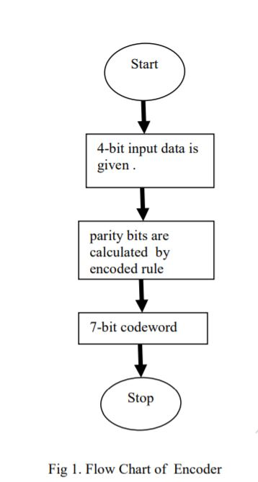
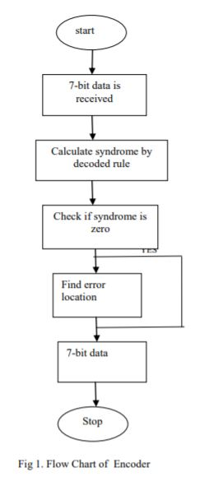
Flowchart of Encoder and Decoder-

Slide 37
CODE
ENCODING OF (7, 4) HAMMING CODE:
Here, we consider a (7,4) Hamming code. We have to take a parity check matrix P. We have to generate a GENERATOR MATRIX. In order to generate a G matrix we need a identity matrix of order (n-k), where, n =7 and k = 4. n here is block length and k is message bit length
G = [P I];
Where , P = Parity Check Matrix
I = Identity matrix of order 3 by 3.
Now, we generate a PARITY CHECK MATRIX (H)
H = [eye(k-1,k-1) P'];
Where, eye(k-1,k-1) = Identity matrix of order 3by 3
P’ = Transpose of a parity check matrix
Now, Message Bits are taken for all combinations. The C ,i.e. , Code Word matrix is generated as follows, and, it is converted into binary and displayed.
C = m*G;
C = modulo(C,2);
disp(C, 'Code words of Hamming code')

Slide 38
Now, error correction capability ad error detection capability is calculated using the following formulae:
ErrDet=(MinHamDist -1)/2
disp (ErrDet, 'error correction capability - t :' )
//1 for Hamming codes
//Calculation of error detection capability
ErrCorr= (MinHamDist -1)
disp(ErrCorr, "error detection capability")
//2 for Hamming codes
ReceivedCodeWordMat=C
R= [ReceivedCodeWordMat(round(16*rand()),:)]
disp( R, 'Randomly generated Received Code word R')
Now, we randomly receive a codeword by getting random error position for numbers between 0 to 7 and display it
// Generate error at random bit position
ErrPos = round(8*rand()) //Get random number between 0 to 7
disp(ErrPos , "error position")

Slide 39
DECODING OF RECEIVED CODEWORD
Consider codeword received from encoding. We will decode this codeword
So consider,
y=R where,
R = Received Codeword
Now, we find syndrome to find out the error
syndrome=modulo(y*(H)',2)
Add the corrected factor according to the syndrome achieved and convert it into binary form
Example-
if(syndrome==[0 0 0]) then
q=modulo([0 0 0 0 0 0 0]+y,2)
message=[q(4) q(5) q(6) q(7)]
Now, display the syndrome, corrected sequence and message decoded
disp("The syndrome is:")
disp(syndrome) disp("The corrected sequence is:")
disp(q)
disp("The message decoded is:")
disp(message)

Slide 40
OUTPUT 1-
identity matrix
1. 0. 0. 0.
0. 1. 0. 0.
0. 0. 1. 0.
0. 0. 0. 1.
coefficient matrix
1. 1. 0.
0. 1. 1.
1. 1. 1.
1. 0. 1.
generator matrix G
1. 1. 0. 1. 0. 0. 0.
0. 1. 1. 0. 1. 0. 0.
1. 1. 1. 0. 0. 1. 0.
1. 0. 1. 0. 0. 0. 1.

Slide 41
parity check matrix H
1. 0. 0. 1. 0. 1. 1.
0. 1. 0. 1. 1. 1. 0.
0. 0. 1. 0. 1. 1. 1.
Code words of Hamming code
0. 0. 0. 0. 0. 0. 0.
1. 0. 1. 0. 0. 0. 1.
1. 1. 1. 0. 0. 1. 0.
0. 1. 0. 0. 0. 1. 1.
0. 1. 1. 0. 1. 0. 0.
1. 1. 0. 0. 1. 0. 1.
1. 0. 0. 0. 1. 1. 0.
0. 0. 1. 0. 1. 1. 1.
1. 1. 0. 1. 0. 0. 0.
0. 1. 1. 1. 0. 0. 1.
0. 0. 1. 1. 0. 1. 0.
1. 0. 0. 1. 0. 1. 1.
1. 0. 1. 1. 1. 0. 0.
0. 0. 0. 1. 1. 0. 1.
0. 1. 0. 1. 1. 1. 0.
1. 1. 1. 1. 1. 1. 1.

Slide 42
Hamming weight
0.
3.
4.
3.
3.
4.
3.
4.
3.
4.
3.
4.
4.
3.
4.
7.

Slide 43
error correction capability - t :
1.//It is one for hamming code
error detection capability
2.// It is 2 for hamming code
Randomly generated Received Code word R
1. 1. 1. 0. 0. 1. 0.
error position:
6.// getting random error position
The syndrome is:
1. 1. 1.//parity bit
The corrected sequence is:
1. 1. 1. 0. 0. 1. 0.
The message decoded is:
0. 0. 1. 0.

Slide 44
OUTPUT2-
Randomly generated Received Code word R
0. 1. 1. 0. 1. 0. 0.
error position
5.//getting random error position
The syndrome is:
0. 1. 1.//parity bit
The corrected sequence is:
0. 1. 1. 0. 1. 0. 0.
The message decoded is:
0. 1. 0. 0.

Slide 45
THANK YOU

